Slide 1
Strings and its operations

Slide 2
A String in C programming is a sequence of characters terminated with a null character ‘\0’.
The C String is stored as an array of characters.
The difference between a character array and a C string is that the string in C is terminated with a unique character ‘\0’.

Slide 3
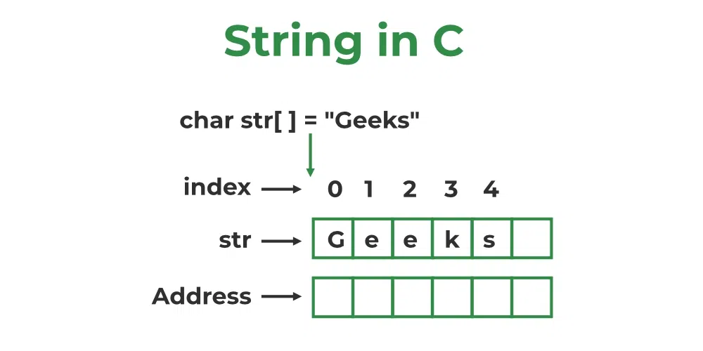

Slide 4
C String Declaration Syntax
Declaring a string in C is as simple as declaring a one-dimensional array. Below is the basic syntax for declaring a string.
char string_name[size];
In the above syntax string_name is any name given to the string variable and size is used to define the length of the string, i.e the number of characters strings will store.
There is an extra terminating character which is the Null character (‘\0’) used to indicate the termination of a string that differs strings from normal character arrays.

Slide 5
C String Initialization
A string in C can be initialized in different ways. We will explain this with the help of an example.
Below are the examples to declare a string with the name str and initialize it with “GeeksforGeeks”.
We can initialize a C string in 4 different ways which are as follows:
1. Assigning a String Literal without Size
String literals can be assigned without size. Here, the name of the string str acts as a pointer because it is an array.
char str[] = “Apple";

Slide 6
2. Assigning a String Literal with a Predefined Size
String literals can be assigned with a predefined size.
But we should always account for one extra space which will be assigned to the null character.
If we want to store a string of size n then we should always declare a string with a size equal to or greater than n+1.
char str[50] = “Apple";

Slide 7
3. Assigning Character by Character with Size
We can also assign a string character by character. But we should remember to set the end character as ‘\0’ which is a null character.
char str[6] = { ‘A',‘p',‘p',‘l',‘e','\0'};
4. Assigning Character by Character without size
We can assign character by character without size with the NULL character at the end. The size of the string is determined by the compiler automatically.
char str[] = { ‘A',‘p',‘p',‘l',‘e','\0'};

Slide 8
Read a String Input From the User
// C program to read string from user
#include<stdio.h>
int main()
{
// declaring string
char str[50];
// reading string
scanf("%s",str);
// print string
printf("%s",str);
return 0;
}

Slide 9
Array of Strings in C
// of strings
#include <stdio.h>
// Driver code
int main()
{
char arr[3][10] = {“Apple", “Orange", “Kiwi"};
printf("String array Elements are:\n");
for (int i = 0; i < 3; i++)
{
printf("%s\n", arr[i]);
}
return 0;
}

Slide 10
Invalid Operations in Arrays of Strings
We can’t directly change or assign the values to an array of strings in C.
Here, name= “Ram”; // This will give an Error that says assignment to expression with an array type.

Slide 11
Important String Functions
No. | Function | Description
1) | strlen(string_name) | returns the length of string name.
2) | strcpy(destination, source) | copies the contents of source string to destination string.
3) | strcat(first_string, second_string) | concats or joins first string with second string. The result of the string is stored in first string.
4) | strcmp(first_string, second_string) | compares the first string with second string. If both strings are same, it returns 0.
5) | strrev(string) | returns reverse string.
6) | strlwr(string) | returns string characters in lowercase.
7) | strupr(string) | returns string characters in uppercase.

Slide 12
strlen() function
The strlen() function in C calculates the length of a given string. The strlen() function is defined in string.h header file. It doesn’t count the null character ‘\0’.
Syntax of C strlen()
The syntax of strlen() function in C is as follows:
size_t strlen(str);
Parameters
The strlen() function only takes a single parameter.
str: It represents the string variable whose length we have to find.
Return Value
This function returns the integral length of the string passed.

Slide 13
// c program to demonstrate
// example of strlen() function.
#include <stdio.h>
#include <string.h>
int main()
{
// defining string
char str[] = “Welcome";
// getting length of str using strlen()
int length = strlen(str);
printf("Length of string is : %d", length);
return 0;
}

Slide 14
strcpy()
strcpy( dest, src);
Parameters: This method accepts the following parameters:
dest: destination array where the content is to be copied.
src: string which will be copied.

Slide 15
#include<stdio.h>
#include <string.h>
int main(){
char ch1[20]={“Hello”};
char ch2[20];
strcpy(ch2,ch1);
printf("Value of second string is: %s",ch2);
return 0;
}

Slide 16
strcat() Function
Syntax
strcat(dest, src);
The terminating character at the end of dest is replaced by the first character of src.
Parameters
dest: Destination string
src: Source string

Slide 17
strncat()
Concatenates first n characters of one string to another.

Slide 18
#include <stdio.h>
int main()
{
char dest[50] = "This is an";
char src[50] = " example";
printf("dest Before: %s\n", dest);
// concatenating src at the end of dest
strcat(dest, src);
printf("dest After: %s", dest);
return 0;
}

Slide 19
C strcmp()
strcmp() is a built-in library function that is used for string comparison. This function takes two strings (array of characters) as arguments, compares these two strings lexicographically, and then returns 0,1, or -1 as the result.
Syntax of strcmp() in C
strcmp(first_str, second_str );

Slide 20
Syntax of strcmp() in C
strcmp(first_str, second_str );

Slide 21
#include<stdio.h>
#include<string.h>
int main()
{ char dest[50] = "This is an";
char src[50] = " example";
printf("dest Before: %s\n", dest);
strncat(dest , src,3);
printf("dest After: %s", dest);
return 0; }

Slide 22
Return Value of strcmp() in C
The strcmp() function returns three different values after the comparison of the two strings which are as follows:
1. Zero ( 0 )
A value equal to zero when both strings are found to be identical. That is, all of the characters in both strings are the same.
2. Greater than Zero ( > 0 )
A value greater than zero is returned when the first not-matching character in first_str has a greater ASCII value than the corresponding character in second_str or we can also say that if the character in first_str is lexicographically after the character of second_str, then zero is returned.
3. Lesser than Zero ( < 0 )
A value less than zero is returned when the first not-matching character in first_str has a lesser ASCII value than the corresponding character in second_str. We can also say that if the character in first_str is lexicographically before the character of second_str, zero is returned.

Slide 23
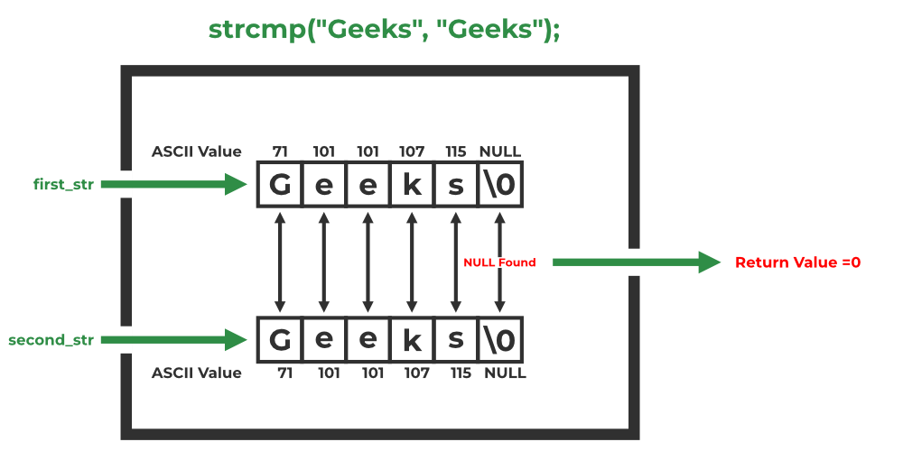

Slide 24
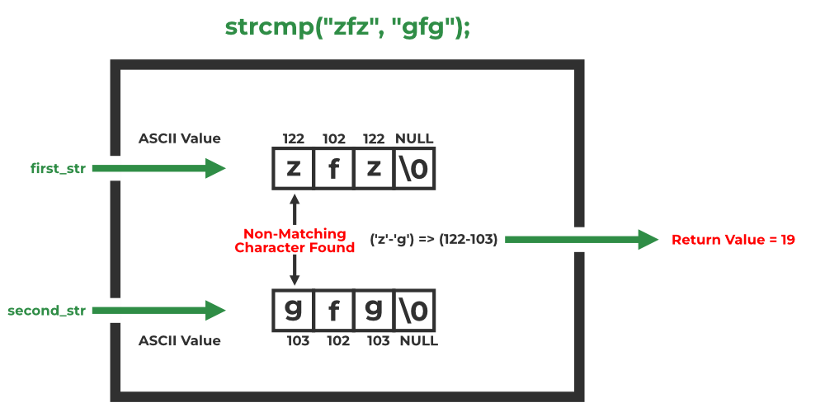

Slide 25
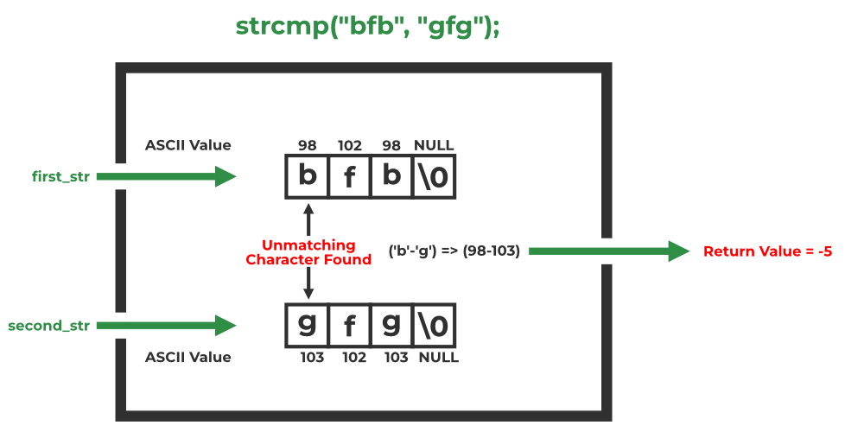

Slide 26
/ C program to illustrate
// strcmp() function
#include<stdio.h>
#include<string.h>
int main()
{
char first_str[] = "g f g";
char second_str[] = "g f g";
// Using strcmp()
int res = strcmp(first_str, second_str);
if (res==0)
printf("Strings are equal");
else
printf("Strings are unequal");
printf("\nValue returned by strcmp() is: %d" , res);
return 0;
}

Slide 27
C Reverse String: strrev()
#include<stdio.h>
#include <string.h>
int main(){
char str[20];
printf("Enter string: ");
gets(str);//reads string from console
printf("String is: %s",str);
printf("\nReverse String is: %s",strrev(str));
return 0;
}

Slide 28
C String Lowercase: strlwr()
The strlwr(string) function returns string characters in lowercase. Let's see a simple example of strlwr() function.
#include<stdio.h>
#include <string.h>
int main(){
char str[20];
printf("Enter string: ");
gets(str);//reads string from console
printf("String is: %s",str);
printf("\nLower String is: %s",strlwr(str));
return 0;
}

Slide 29
C String Uppercase: strupr()
The strupr(string) function returns string characters in uppercase. Let's see a simple example of strupr() function.
#include<stdio.h>
#include <string.h>
int main(){
char str[20];
printf("Enter string: ");
gets(str);//reads string from console
printf("String is: %s",str);
printf("\nUpper String is: %s",strupr(str));
return 0;
}

Slide 30
String Functions
<string.h> header file contains the following functions:
strncpy() | Copy first n characters of one string to another.
strncat() | Concatenates first n characters of one string to another.
strncmp() | Compares first n characters of two strings.

